Slide 1
FEATURE analysis
Feature Importance – Support Vector Machine (SVM)
Notes:
I will present feature analysis which is commonly known as feature importance.
The feature importance that I will explain is derived from one of the popular machine learning classifiers, that is “support vector machine - SVM classifier.
So we need to run our data using an SVM classifier to get an SVM model, after that we can perform feature importance

Slide 2
Intuition of Feature Analysis
Feature Weight (Importance) of SVM → The importance of each feature
Models | Features
Baseline (M₀) | 3 Common features (A, B, C)
Proposed (M₁) | 3 Common features + 3 new additional features (P, Q, R)
Accuracy: 78% → X Accuracy: 63%
Notes:
Before further explanation, I will explain why we need feature importance.
As the name, feature importance is used to define which feature that affects the most in producing better accuracy. Or which one is the most important feature in producing better accuracy.
In other words, if we delete this most important feature, then our accuracy will be reduced.
This feature analysis also important for experiment that want to test new additional features. Suppose, we have baseline consists of 3 common features (A, B, C), and Proposed combine the common features and new additional features (P, Q, R). So for proposed there are 6 features.
When test the proposed model which contain all features, we analyse is there any additional feature that is important than common features. When we see this chart, we know that P, one of the additional features is the most important among others. If we delete this feature, it will weaken the performance.

Slide 3
Data Science Flow
Let`s start!
1
Data Collection
2
Data Preprocessing
3
Feature Selection
4
Experiment Design
5
Modelling
6
Result Analysis
7
Feature Analysis
Notes:
In the Data science flow experiment, feature importance is used in feature analysis, after we test the model and get the result.

Slide 4
FEATURE WEIGHT
Feature Importance – SVM
Notes:
Back again to explain the feature importance of SVM model.

Slide 5
Outline
SVM Summary
Which part of SVM model that needs to be highlighted
Feature Importance
Definition of feature importance
How to perform feature importance
Calculation to get the importance for each variable/feature
Notes:
This is the outline for explaining feature importance material.
First, briefly explain about SVM. Before jump to explaining feature importance, we need to understand which part SVM that must be highlighted in performing feature importance
Next explaining the feature importance itself.
And Last Step by step how to perform feature importance and its implementation both manually and using code
First, briefly explain about SVM, which part SVM that must be highlighted

Slide 6
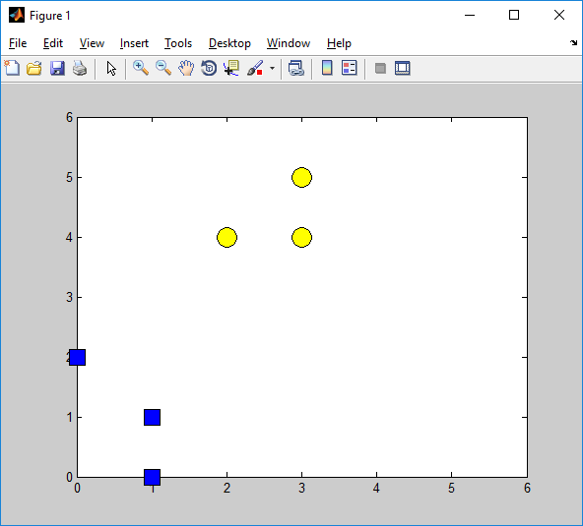
Data
Point | [A, B] | class
X₁ | [1, 1] | Negative
X₂ | [1, 0] | Negative
X₃ | [0, 2] | Negative
X₄ | [2, 4] | Positive
X₅ | [3, 5] | Positive
X₆ | [3, 4] | Positive
B
positive data
X₅
X₄
X₆
X₃
X₁
negative data
X₂
A
Notes:
For example we have this kind of Data.
There are 6 data points, the second column is their feature values (there are two features, feature A and B), and the last column is the class, there are 2 classes (negative and positive).
According to this data points, we can plot each point and this is the illustration of the data. Yellow is for class positive, and blue is class negative.

Slide 7

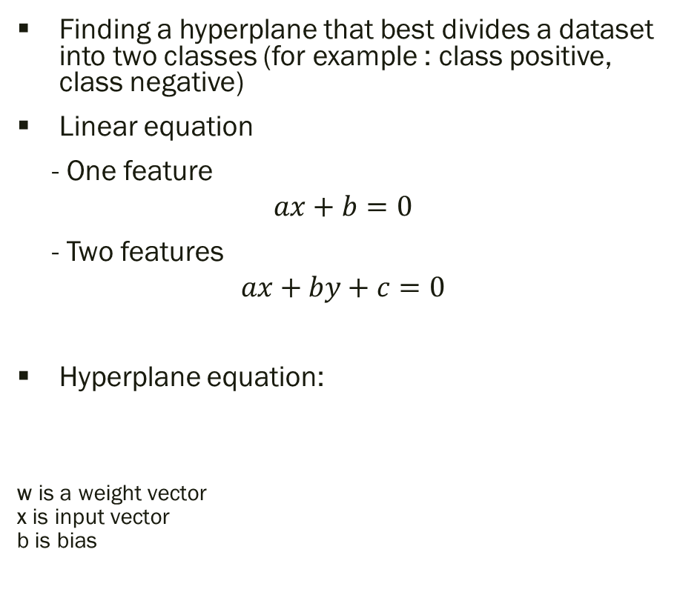
SVM
Finding a hyperplane that best divides a dataset into two classes (for example : class positive, class negative)
Linear equation
- One feature
$$ax+b=0$$
- Two features
$$ax+by+c=0$$
Hyperplane equation:
w is a weight vector
x is input vector
b is bias
B
positive data
Hyperplane
$$w^{T}x+b=0$$
negative data
A
Notes:
Next, we discuss which part of SVM that needs to be highlighted?
Most of you are familiar with SVM.
SVM is popular due to its hyperplane that best divides data into two classes.
For example this is a hyperplane, it can best divide positive and negative classes.
Hyperplane is similar to linear line
However, a hyperplane is different from a linear equation.
Linear equation, if we use 1 feature, then the equation will be 𝑎𝑥+𝑏=0 where 𝑎 and 𝑥 is a coefficient and input data of 1 feature, if two features become 𝑎𝑥+𝑏𝑦+𝑐=0, where 𝑏 and 𝑦 is the second coefficient and the second feature, and soon. Total coefficients are in line with the total features.
But for hyperplane SVM, the equation is 𝒘^{𝑻}𝒙+𝑏=0, where 𝒙 is the input data in vector and 𝒘 is coefficient/weight vector

Slide 8
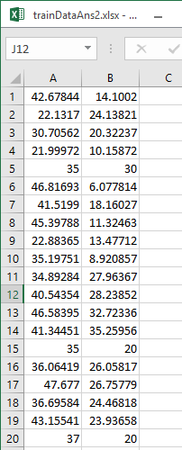


SVM - Hyperplane formula
$$x − input$$
Why $w^{T}x+b=0$? Not $ax+by+c=0$or $y=mx+b$?
Make it easy if dealing with more than 2 features
$w^{T}=\left[{\text{α}}_{1},{\text{α}}_{2},{\text{α}}_{3},…{\text{α}}_{n}\right]$
$x^{T}=\left[{\text{x}}_{1},{\text{x}}_{2},{\text{x}}_{3},…{\text{x}}_{n}\right]$
Can easily convert to y = mx + b form.
Notes:
Why is the equation of a hyperplane like this? Which is not the same as a linear equation? Because a hyperplane equation deals with more than 2 features. No matter how many features there are, the equation remains the same.
So the total weight depends on the input data. If total input data equals to 20, then the weight equals to 20 no matter how many features included in each data.
According to this example, actually we can easily convert the equation to y = mx + b but in SVM we use different equation just want to emphasise that we deal with multiple features

Slide 9
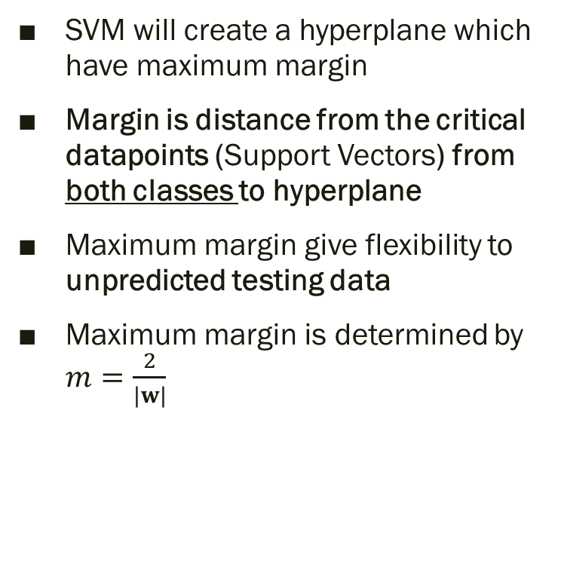
SVM Goals: Maximum margin
SVM will create a hyperplane which have maximum margin
Margin is distance from the critical datapoints (Support Vectors) from both classes to hyperplane
Maximum margin give flexibility to unpredicted testing data
Maximum margin is determined by $m=\frac{2}{|w|}$
B
Support Vectors
positive data
negative data
A
Notes:
Beside hyperplane, SVM goals also want to maximise the margin.
Margin is distance from the critical datapoints (Support Vectors) from both classes to hyperplane. We said critical data because some of these datas are the closest to the other class.
(show animation)
So, Why we won’t consider these margins which have different distances from a hyperplane to each class? Because if there is unpredicted testing data (triangle), the model can give a flexible and fair class according to its distance.
In SVM, the maximum margin is determined by the following equation 2/|w|

Slide 10
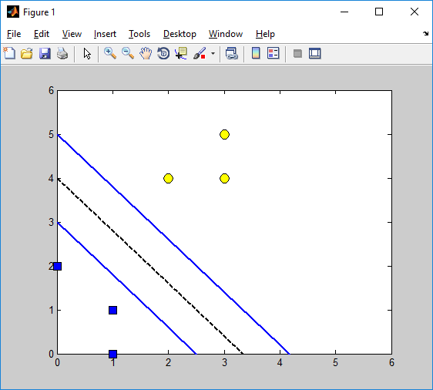
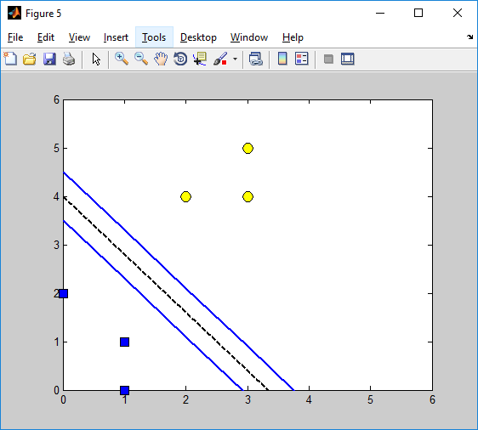
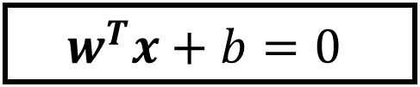

Feature Weight - SVM
SVM model produces the best hyperplane which has maximum margin
The best weight ($w$) also depends on support vectors containing features ($A,B$), thus Feature Weight of each support vector has important role in forming a hyperplane
$$w^{T}x+b=0$$
x₂
B
positive data
m
w^{T} x + b = 1
w^{T} x + b = 0
w^{T} x + b = -1
negative data
A
x₁
Notes:
After discussing the best margin (distances of two classes are the same), now we discuss the best hyperplane which has maximum margin.
Why is the best hyperplane not like this, or like this (show animation)?.
Because one of the main factors to generate the best hyperplane in SVM depends on the best weight. The best weight that we are talking about is the weight of support vectors (the critical data points of each class) which include all features.
So we can say that feature weight of each support vector have important role in generating the best hyperplane

Slide 11
Outline
SVM Summary
Which part of SVM model that needs to be highlighted
Feature Importance
Definition of feature importance
How to perform feature importance
Calculation to get the importance for each variable/feature
Notes:
Now we introduce feature importance

Slide 12
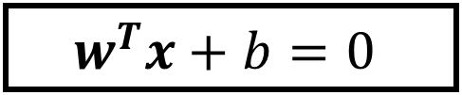

Feature Importance - Feature Weight
Each critical datapoint (support vector) has the weight ($w$). It is important for each datapoint because representing the critical class of datapoint (positive class/negative class) →closest to other class
To find the important variable on SVM classifier, feature weight is needed
B
positive data
$$w^{T}x+b=0$$
m
w^{T} x + b = 1
w^{T} x + b = 0
w^{T} x + b = -1
negative data
A
Notes:
According to the previous explanation, feature Importance is associated with the feature weight of the SVM model that is derived from the best hyperplane which has maximum margin.
One of the important factor to generate feature weight is the critical datapoints of support vectors.
Each critical datapoint (support vector) has the weight (𝑤). It is important for each datapoint because representing the critical class of datapoint (positive class/negative class)
So, to find the important feature on SVM classifier, feature weight is needed

Slide 13
Outline
SVM Summary
Which part of SVM model that needs to be highlighted
Feature Importance
Definition of feature importance
How to perform feature importance
Calculation to get the importance for each variable/feature
Notes:
Step by step how to perform feature importance and its implementation both manually and using code

Slide 14
Implementation
Classify using SVM
Read data with 2 features
Train with SVM
Get model
Feature Weight
Find the weight (sv_coef) and input/support vector (SVs)
Calculate feature weight
Sort all the feature weight.
The highest feature weight means the feature is the most important variable
Notes:
Classify using SVM to get the model.
SVM Model produced is used to find feature importance using feature weight
The highest feature weight means the feature is the most important variable

Slide 15
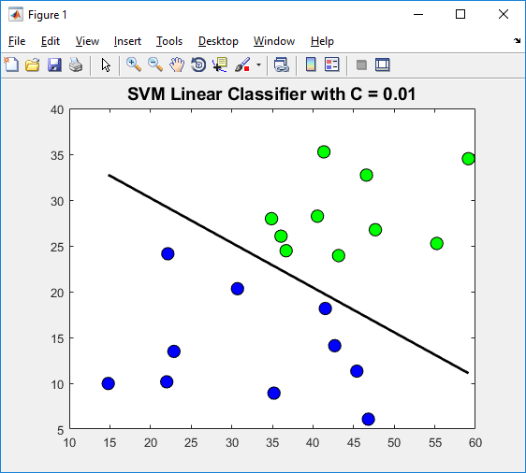
Classify using SVM to get SVM Model
Source: Data
Notes:
First step: classify data using SVM classifier to get SVM Model. Suppose we trained these 20 datas which contains 2 features, A and B. This is the hyperplane illustration after we trained the data and then got the SVM Model.

Slide 16
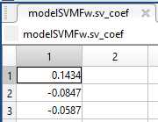
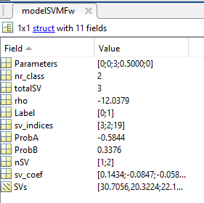
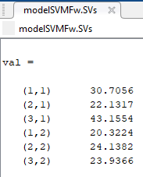
SVM Model
Output: SVM model
Index of support vectors
over input vectors
Support vectors coefficients
Detail input data of support vector
Notes:
This is the inside of the SVM Model when we implement using MATLAB.
Pay attention to these 3 boxes because they have relation to the feature importance calculation.
According to sv_indices, we know that there are only 3 support vectors. So, among 20 datas, the index of support vectors are 3,2, and 19.
Because we only have 3 support vectors, then the total of our weight (sv_coef) also equals 3.
SVs is the detailed information of support vectors. Because there are 3 SV and 2 features, then there are 6 pieces of information. First three is for feature A, the last three for feature B

Slide 17

Implementation - feature importance
$$w^{T}x+b=0$$
$$feature weight(FW)=Abs\left({modelSVMFw.sv_coef}^{′}∗modelSVMFw. SVs\right)$$
Notes:
This is implementation of feature importance. I will present the feature importance calculation both manually and using MATLAB code.
Regarding previous explanation, hyperplane equation of SVM is 𝒘^{𝑻}𝒙+𝑏=0 and feature weight information is determined by 𝒘^{𝑻}𝒙.
Therefore, to calculate feature importance we will use this code in Matlab (Absolute of transpose weight/coefficient * value of support vector data including the features. )
→ according to sv_indices, index data of 3,2,19 are selected as SV.
Therefore, these 3 weights/coefficients are from 3,2,19 data

Slide 18
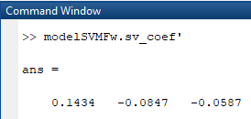
Implementation
$$FW=Abs\left({modelSVMFw.sv_coef}^{′}∗modelSVMFw.SVs\right)$$
Feature A
We need to Transpose sv_coef
Notes:
Regarding this equation, we need to transpose the coefficients/weights then we can multiplied by the support vector data including its features.
This is code that will be used using Matlab when performing feature importance.
→After this I will present a manual implementation on how to calculate this equation. The results of a manual implementation and run using code must be the same.

Slide 19
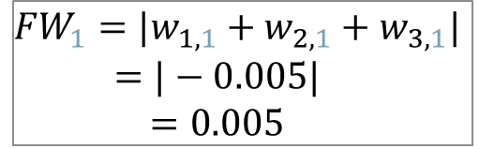
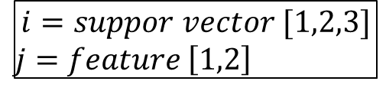
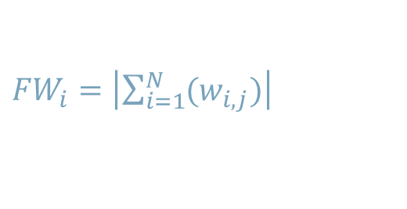

Manual Implementation
$$i=suppor vector [1,2,3]$$
$j=$ $feature \left[1,2\right]$
$$w_{i,j}={sv_coef}_{i}∗{SV}_{i,j}$$
…(1)
…(2)
${FW}_{i}=\left|\sum_{i=1}^{N}{(w_{i,j})}\right|$
Feature A
$$w_{1,1}={sv_coef}_{1}∗{SV}_{1,1}=30.7056∗0.1434 =4.403$$
$w_{2,1}={sv_coef}_{2}∗{SV}_{2,1}=22.1317∗\left(−0.0847\right)=−1.875$
$$w_{3,1}={sv_coef}_{3}∗{SV}_{3,1}=43.1554∗\left(−0.0587\right)=−2.533$$
…(1)
…(2)
$${FW}_{1}=|w_{1,1}+w_{2,1}+w_{3,1}|$$
$$=|−0.005|$$
$$=0.005$$
Feature A
Notes:
Using manual implementation, we have two equations to get feature weight.
To get the importance of each feature,
First, multiplied each weight (coefficient) to each support vector.
Last, summation of the previous results is the importance of the feature.
To understand these two equations, i is for support vector, and j for feature.
For example, if we want to find the importance of feature A (1st index of feature) then we need to apply first equation, multiplying each weight and each support vector data of feature 1.

Slide 20
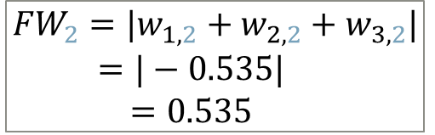
Manual Implementation
$$i=suppor vector [1,2,3]$$
$j=$ $feature \left[1,2\right]$
$$w_{i,j}={sv_coef}_{i}∗{SV}_{i,j}$$
…(1)
…(2)
${FW}_{i}=\left|\sum_{i=1}^{N}{(w_{i,j})}\right|$
Feature B
$w_{1,2}={sv_coef}_{1}∗{SV}_{1,2}=20.3224∗0.1434=2.9$14
$w_{2,2}={sv_coef}_{2}∗{SV}_{2,2}=24.1382∗\left(−0.0847\right)=−2.044$
$$w_{3,2}={sv_coef}_{3}∗{SV}_{3,2}=23.9366∗\left(−0.0587\right)=−1.405$$
…(1)
…(2)
$${FW}_{2}=|w_{1,2}+w_{2,2}+w_{3,2}|$$
$$=|−0.535|$$
$$=0.535$$
Feature B
Notes:
To find the importance of feature B we can use the same process. Multiplied each weight/coefficient to each support vector.
The difference is support vector data we use is the last three since it is the value of feature B

Slide 21
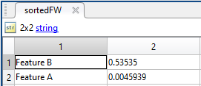


Manual Implementation
Feature A
Feature B
$${FW}_{1}=0.005$$
$${FW}_{2}=0.535$$
Sorted of feature weight (feature importance)
Name | Feature Weight
Feature B | 0.535
Feature A | 0.005
Feature B is selected as the most important variable
Notes:
This is the result of manual implementation.
After we sorted the feature importance results,
Both manual and using code, the feature importance results are the same

